Slide 1

Musala Soft Struct Project
Made by vs7heC0de

Slide 2
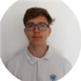
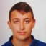
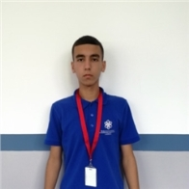
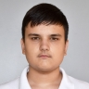
About the team
Aleksander Patrashkov
Kaloyan
Dinev
Stanislav
Todorov
Martin
Bakalov
Scrum Trainer
Back End Dev
Front End Dev
Quality Engineer

Slide 3
Implementation
1. Implementing the tasks
2. Role disturbtion
3. Making the code
4. Code testing
5. Making the documentation and presentation

Slide 4

Our goal
The goal of our project is to create a program which will help teachers to create teams and to make report about the current and the previous students, teachers and teams.

Slide 5






Used technologies

Slide 6

Future plans
To connect the code with data base
To make the user interface more appealing
To connect the code with a network system

Slide 7

Thank you for your attention!

